Slide 1

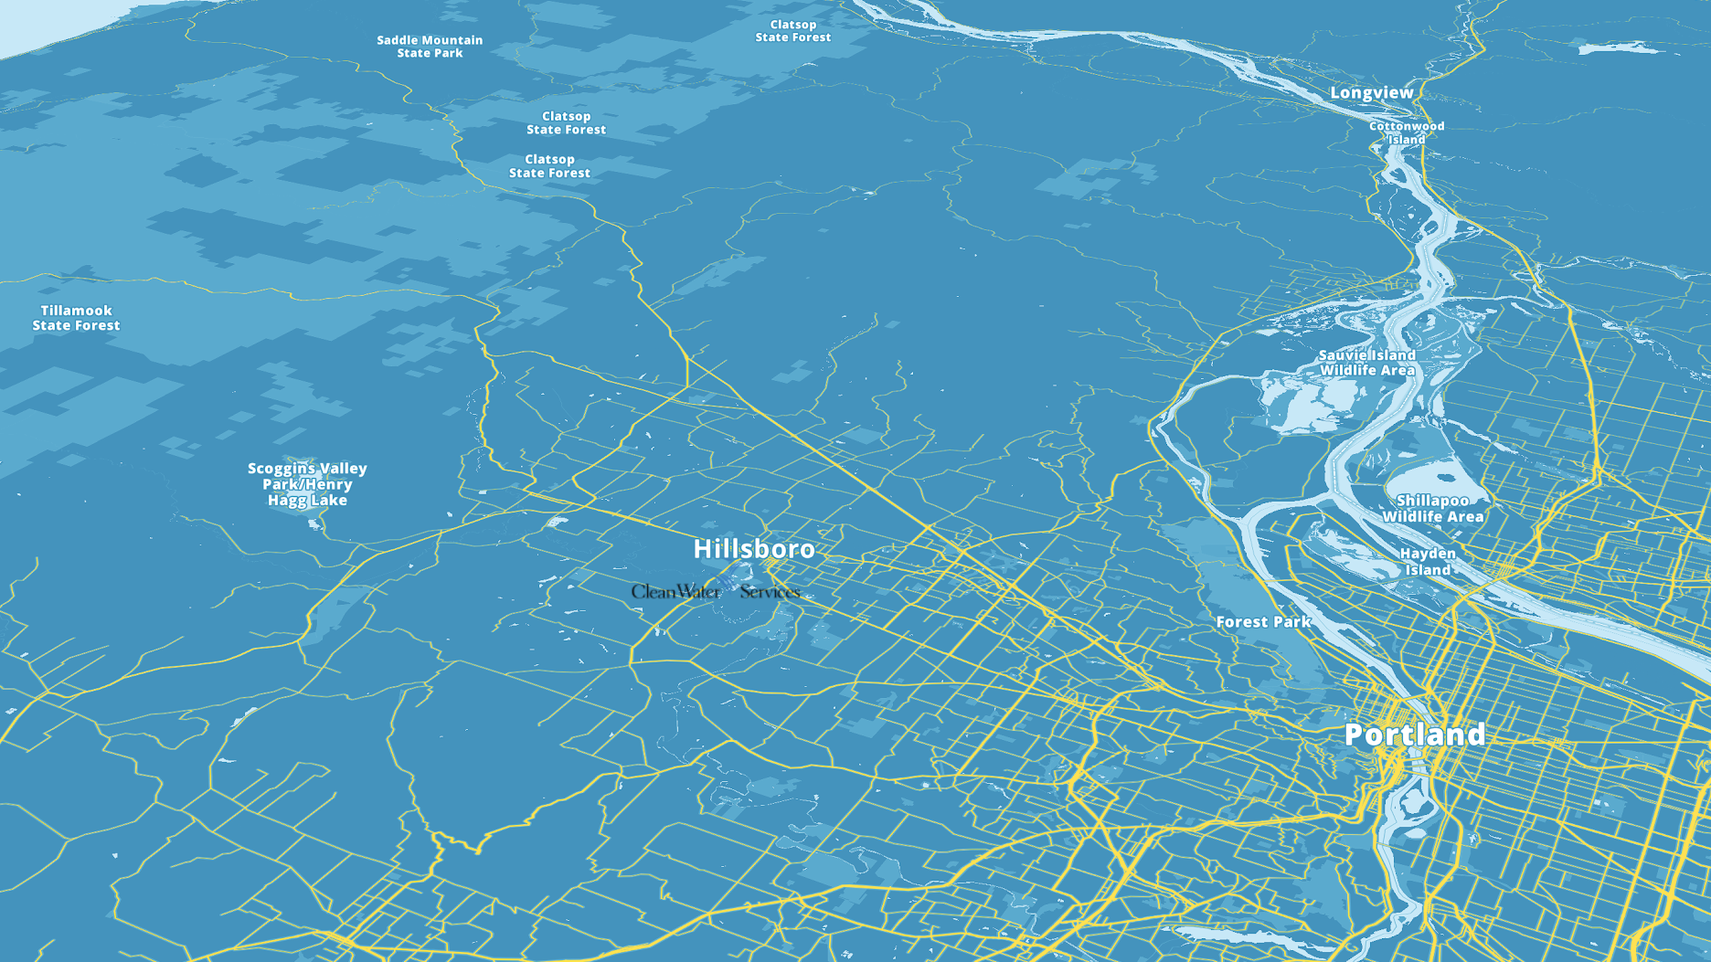
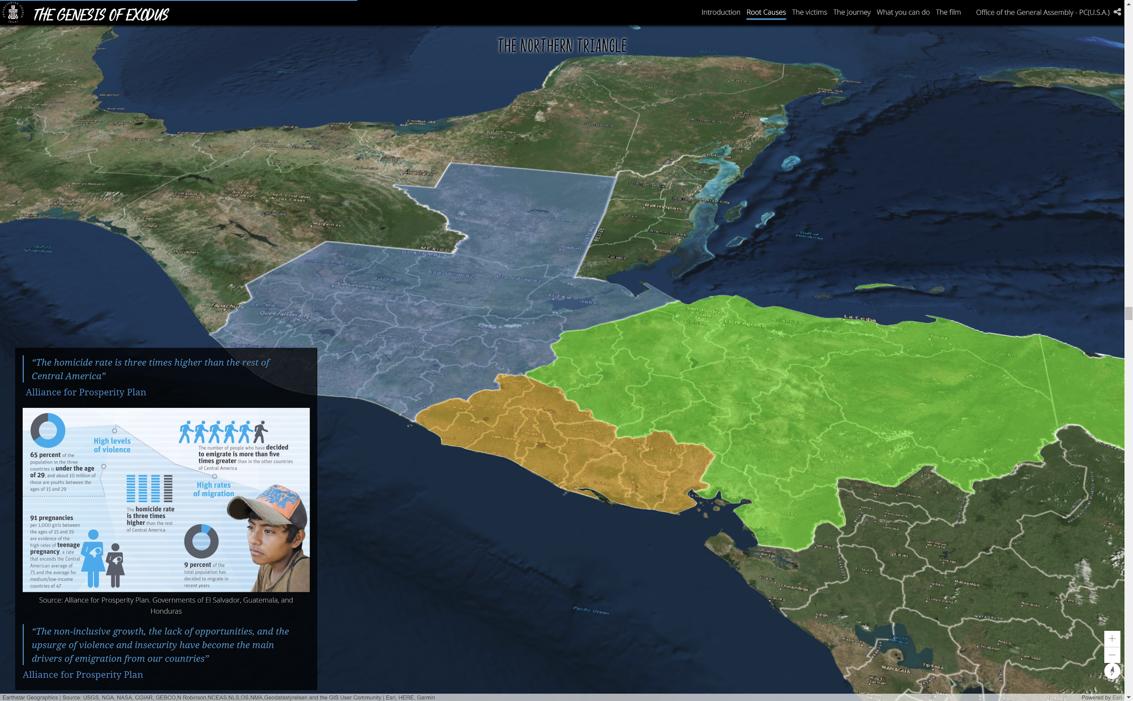
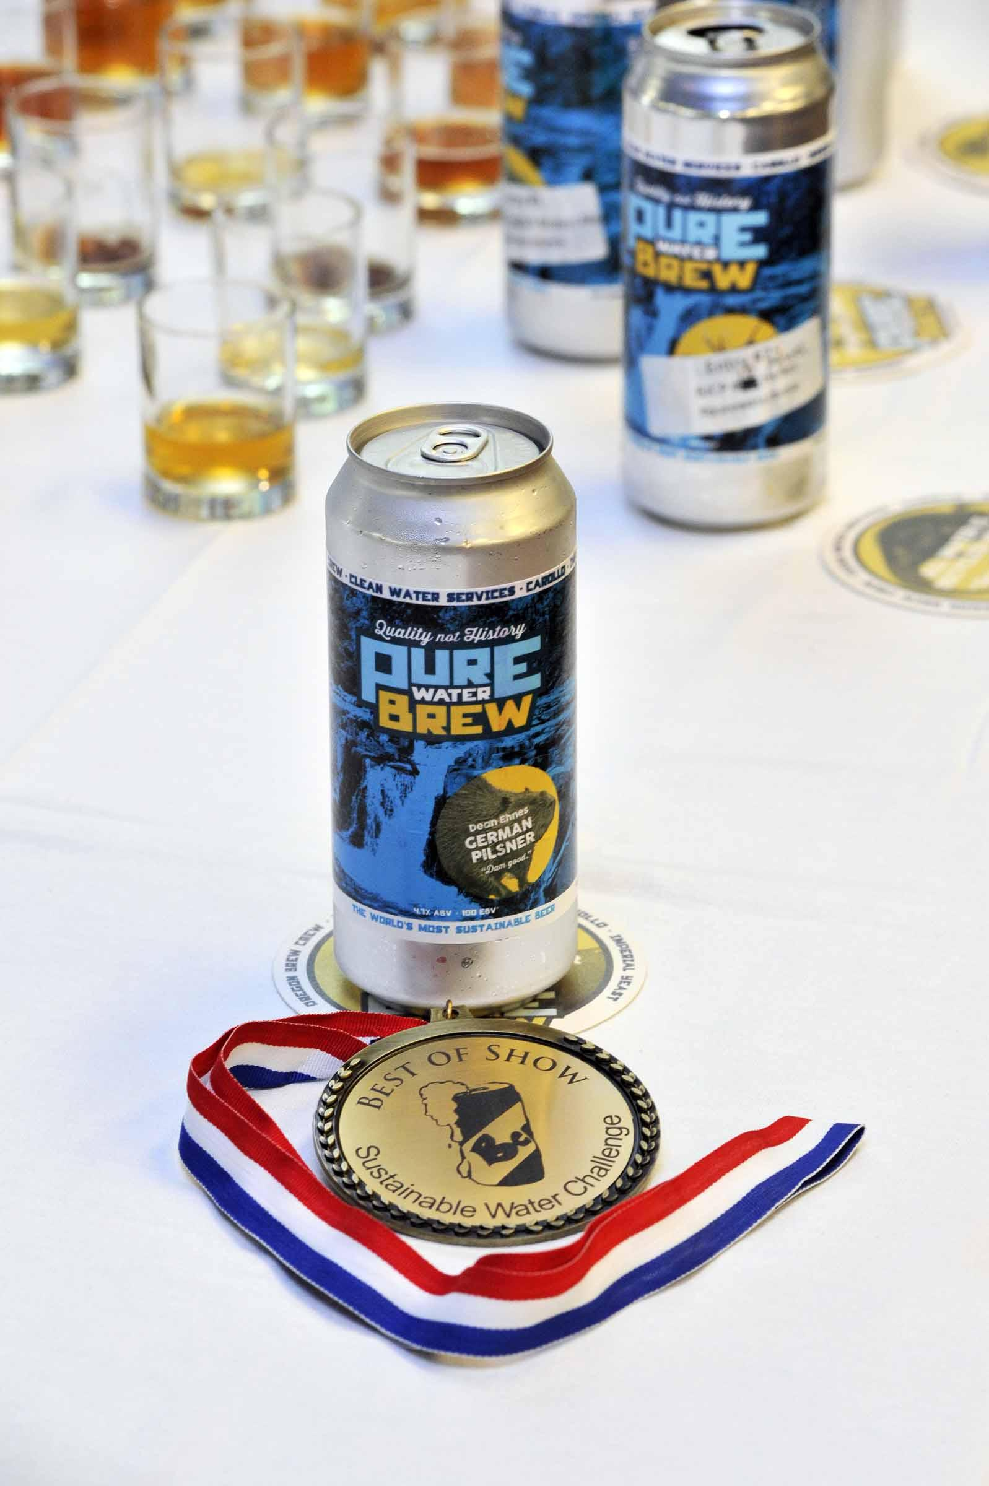
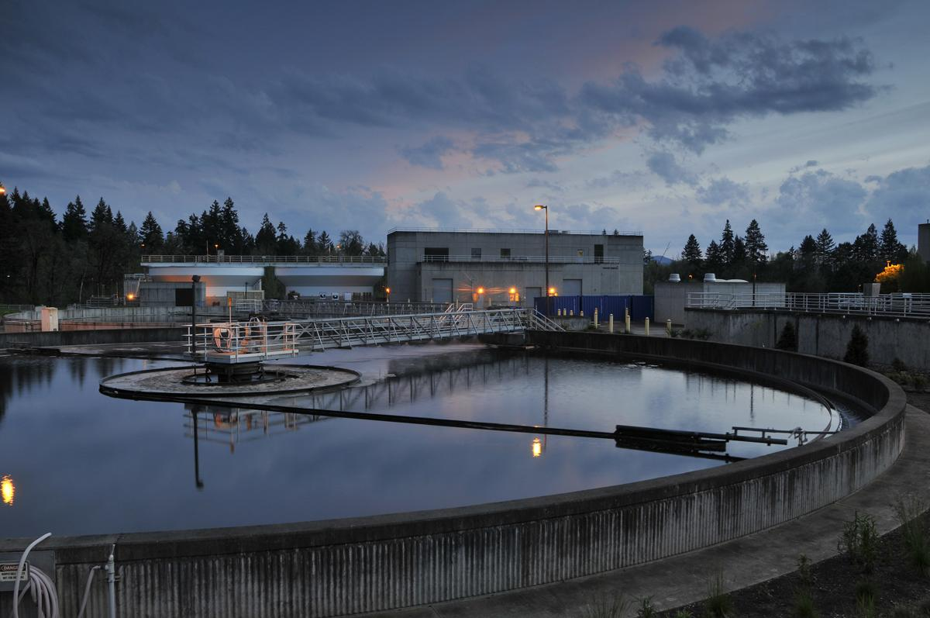
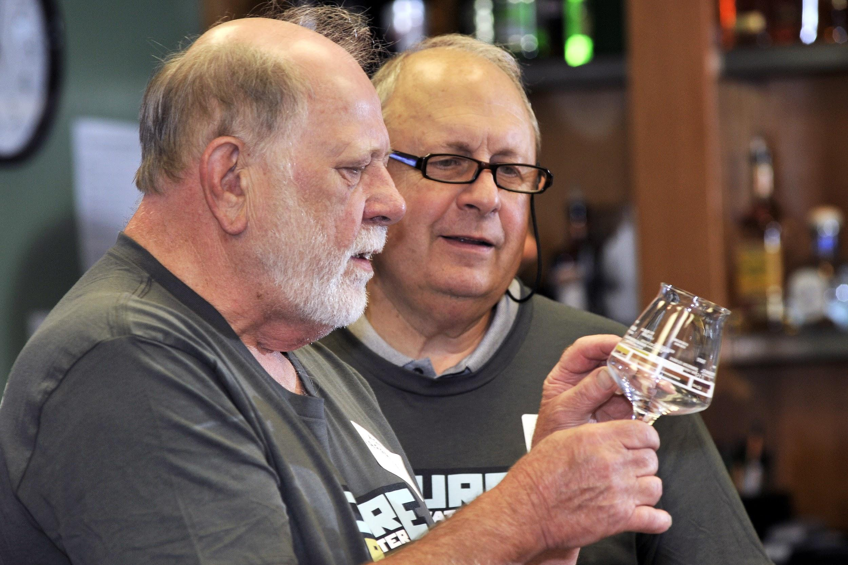
Story map
Ginny Katz | GEOG 4572
Share the journey and vision of
Pure Water Brew,
the US’s first 100% DPR recycled beer, at the Singapore International Water Week 2018.
Specific tools geovisual tools:
Interactive maps and data
Narratives Media
Social Media Data
How Clean Water Services is changing the water reuse
conversation and mindset
with beer.
Example of interested style of Geoviz:
The Genesis of Exodus
Violence, poverty, and social disintegration:
the root causes of Central American migration
http://storymap.genesisofexodusfilm.com/index.html

